Slide 1


Developing a Prediction Model for Sales Prices using
the Ames Housing Dataset
STT 481: Capstone in Statistics
Aditya Pendyala
Michigan State University

Slide 2
Contents
1. Introduction, Exploratory Data Analysis, and Data Pre-Processing
2. Algorithm, Cross Validation, and Hyper-parametric tuning
3. Methodology and technical challenges
4. Model Interpretation
5. Limitations and potential improvements

Slide 3
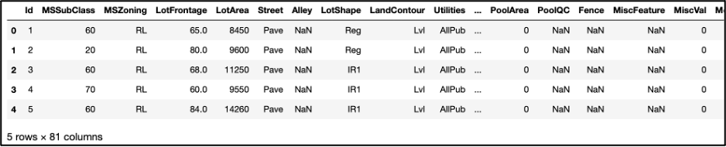
Introduction, Exploratory Data Analysis, and Data Pre-Processing
This project involves the use of Ames Housing Dataset.
79 explanatory variables describing (almost) every aspect of residential homes in Ames, Iowa.
Developing a prediction model that utilizes many of the 79 variables to predict sales prices for each property.
The dataset provided comes in two parts: test.csv and train.csv.
The goal is to use the train.csv file to develop a prediction model and then use the test.csv file to determine the model’s accuracy.
Figure 1: A glimpse into train.csv. Displaying the first 5 rows of the dataset. By excluding ‘Id’ and ‘SalePrice’ variables, there are 79 variables left to work with.

Slide 4
Introduction, Exploratory Data Analysis, and Data Pre-Processing
Loading libraries such as Matplotlib, Pandas, NumPy, Seaborn, and XGBoost, along with modules for splitting data and evaluating models, were imported.
train.csv file was imported using pandas as a data-frame. Many variables had very few non-null values. Some of these variables included: Alley, MasVnrType, FireplaceQu, PoolQC, Fence, and MiscFeature.
Dropping mentioned variables, along with the Id variable.
Each column of train_df_col_drop was first sorted in an ascending order, followed by filling the Na values with forward fill (bfill) method.
Looking at the histogram, it was found that some variables like LotFrontage, YearBuilt, YearRemodAdd, BsmtUnfSF, TotalBsmtSF, GarageYrBlt, and GarageArea had noticeable variability, almost showing bell curves.
Encoded string variables using the pandas get_dummies method.
Correlation plot showing variables that have a strong relation to SalePrice with correlation values greater than 0.60. These variables will likely play a strong role in the prediction model.

Slide 5
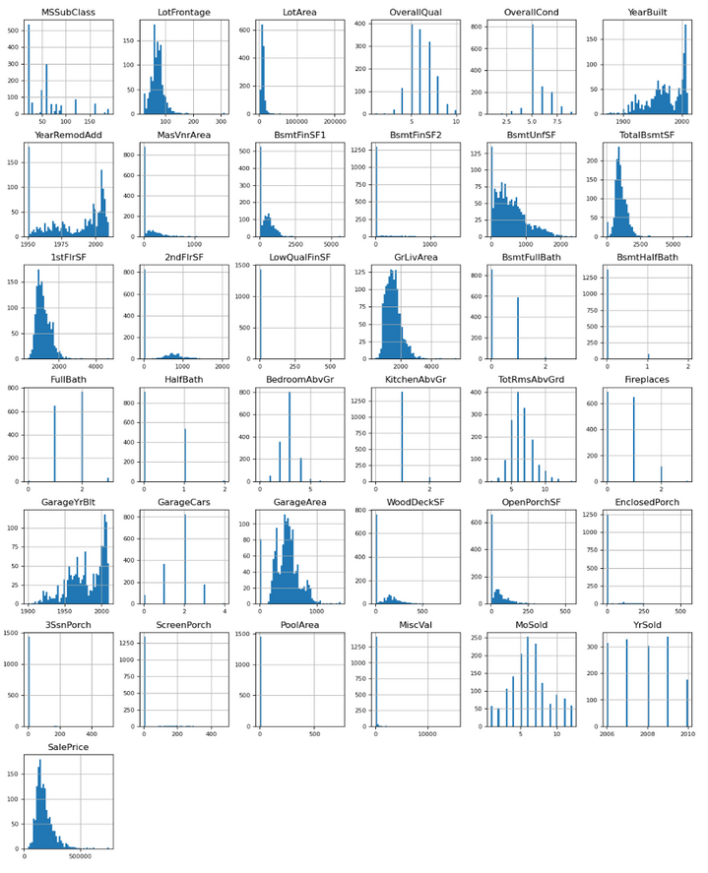
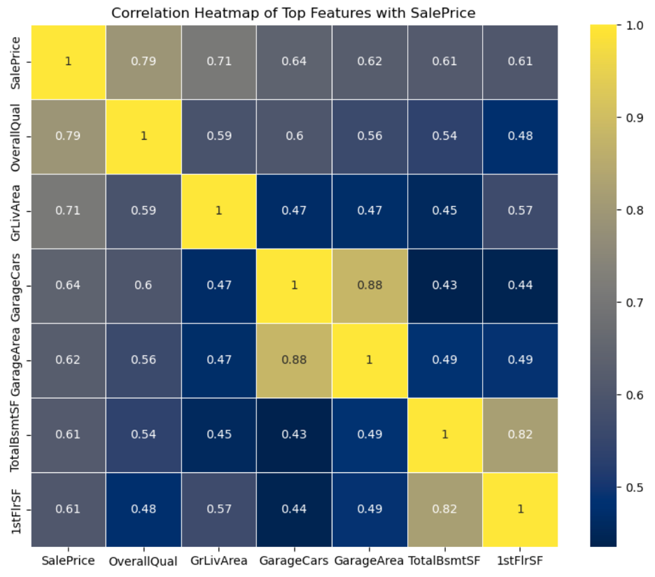
Introduction, Exploratory Data Analysis, and Data Pre-Processing
Figure 2: Understanding the nature of variables in the data through histograms. Some variables show bell-curve like trends, and many show large variability.
Figure 3: Correlation plot showing variables with values above 0.60.

Slide 6
Algorithm, Cross Validation, and Hyper-parametric Tuning
Firstly, the train_encoded data-frame is split into features (X) and SalePrice (y). Next, the data is split into training and testing data (X_train, X_test, y_train, y_test), with the size ration 70:30.
Training data is used to train a XG Boost based model. The XG Boost regressor’s objective is set to “reg:squarederror”’. This model is a preliminary model, with no additional parameters.
Testing this preliminary model on testing data, the R-squared score was 0.902.
Few of the most important parameters for a XG Boost regressor are:
max_depth: Depth of each tree. Higher the depth, stronger the learning and the ability for the tree to overfit.
learning_rate: Higher the value, faster the algorithm will converge to the local minima, but too high might overshoot the minima, and too low might never reach the minima.
n_estimators: Number of boosting rounds.
subsample: Sample of training data to be used in each boosting round. It is important to control overfitting.
colsample_bytree: Number of columns to use when growing a tree. This is also very important to control overfitting.

Slide 7
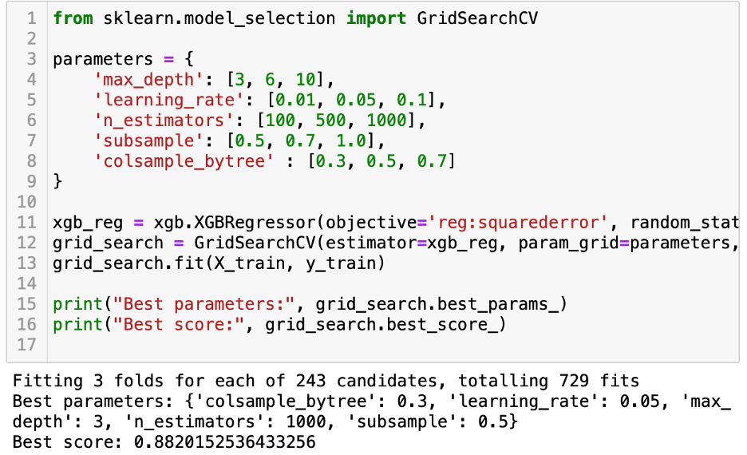
Algorithm, Cross Validation, and Hyper-parametric Tuning
One of the ways to find the best model using those parameters is to use Grid Search. So, using Grid Search, the following values for the parameters were used to find the best performing model.
This model had the score 0.88, and when used for testing, the R-squared value was 0.923, which is an improvement over the preliminary model.
The output shows that 729 fits were performed out of which the best model had the parameters:
max_depth: 3
learning_rate: 0.05
n_estimators: 1000
subsample: 0.5
colsample_bytree: 0.3
Figure 4: Using GridSearch CV to find the best combination of parameters.

Slide 8
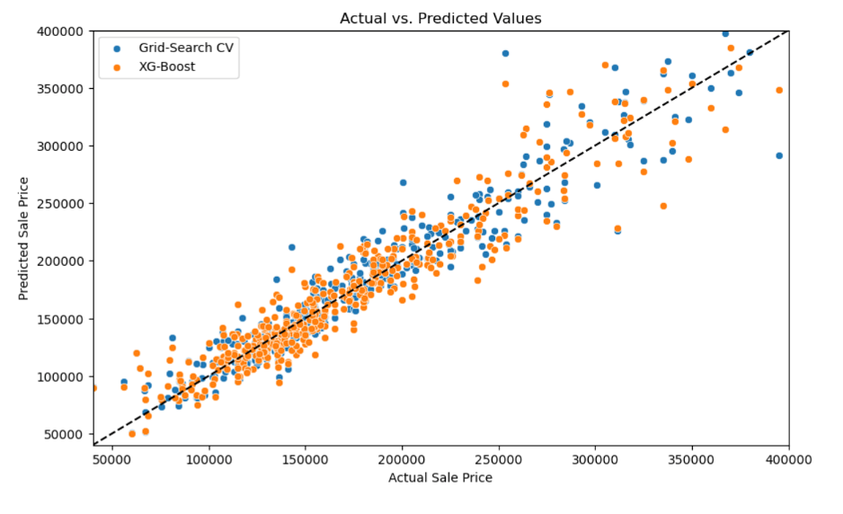
Algorithm, Cross Validation, and Hyper-parametric Tuning
Figure 5: Plotting both the preliminary and hyper-parametrized XG-Boost models. The closer the datapoints to the dashed line, more the accuracy. We can see that the blue dots are fairly closer to the dashed line than the orange dots.

Slide 9
Methodology
XG Boost, short for Extreme Gradient Boosting, is a machine learning algorithm that can handle large amounts of data efficiently.
Dataset consisted of over 70 variables, XG Boost proved to be a suitable regressor.
After handling categorical variables with dummy variables, the number of columns in the data-frame increased to almost 200, making XG Boost the preferred regressor.
XG Boost includes L1 and L2 regularization (Lasso and Ridge Regression) which prevents overfitting and improved model generalization.
This is crucial in complex datasets like those involving real estate where the model needs to generalize well from training data to unseen data.

Slide 10
Technical Challenges
The dataset has over 70 variables, making it difficult to look at each variable separately.
Using a custom function and ffill method, there’s not a lot of proper missing data value handling. Some columns had too many missing values, making them non-viable for regression, but could have been proven useful.
Furthermore, making visualizations to understand the relationship of every variable with SalePrice is difficult due to the large number of variables.
Another major component of technical difficulties is the hyper-parametrization of the regression model. By using multiple values for each parameter, the algorithm had to run 729 different fits, making the process computationally challenging. I overcame this problem by using the argument “ device = ‘cuda’ ”, which is used to specify that the GPU should be used for computation and not the CPU. This can significantly accelerate the training of models.

Slide 11
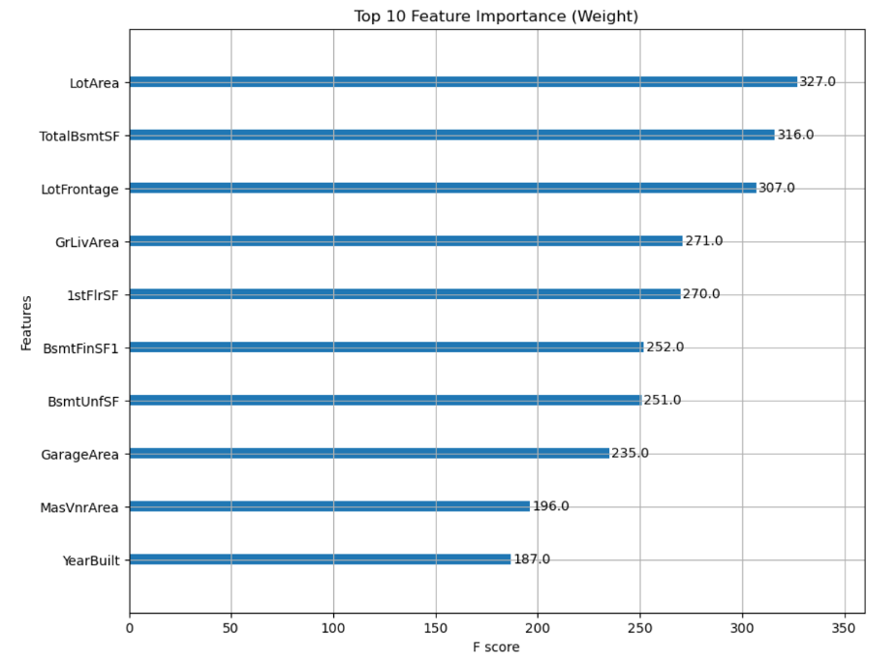
Model Interpretation
Interpreting an XG Boost model involves understanding the influence of features on the predictions and the decision-making process within the model.
XGBoost, while highly effective, can sometimes be considered a "black box" because of its complexity.
But there are some ways to make it interpretable. One of them is to find the variables that have the highest F-scores.
Figure 5:
Plot showing the F scores for the top 10 features for the hyper-parametrized model.

Slide 12
Limitations and Model Improvements
As mentioned earlier, hyper-parametrization is a key component to developing an effective and accurate model.
Due to computational restrictions, the hyper-parametrization carried out was not the best possible. There's still room for improvement in that space and addition of more parameters could lead to better results.
Another space for improvement could be the use of k-fold cross validation, which can lead to better results and lesser overfitting.

Slide 13
Thank you for your time! Have a great summer!

